Slide 2
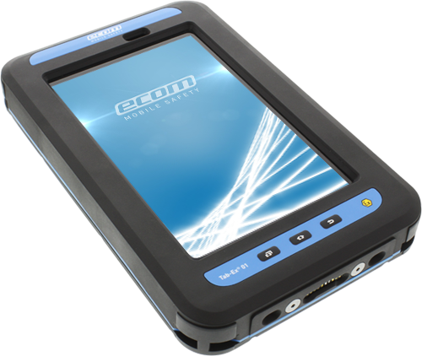
Tab-Ex® 01 Series
ATEX Zone 1/21 & Division 1 / ATEX Zone 2 & Division 2
BENEFITS
The Tab-Ex® 01 is suitable for multiple mobile worker roles performing a range of tasks, such as Asset Surveys, Material Tracking, Operator Rounds, Inspection and Maintenance.
Supports latest Bluetooth standards - allowing realtime connectivity to Bluetooth SmartReady Low Energy 4.0 (BLE).
Expanded capabilities such as data collection and measuring/monitoring devices, headsets, AutoID, and Bluetooth Beacons for localization.
Advanced data capturing functionality due to the CamScan Keyboard app
and the Bluetooth scanner Ident-Ex® 01.
The Tab-Ex® 01 also features Samsung’s exclusive Samsung KNOX and Ultra Power Saving Mode, allowing it to run for days without shutting down.

Slide 3
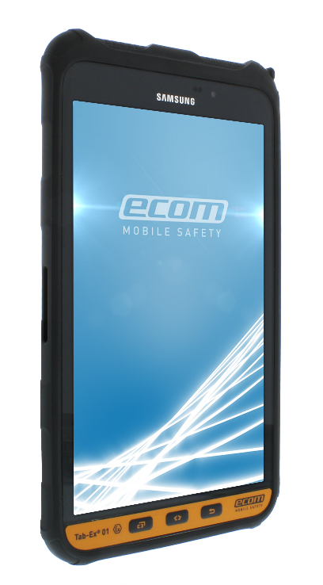
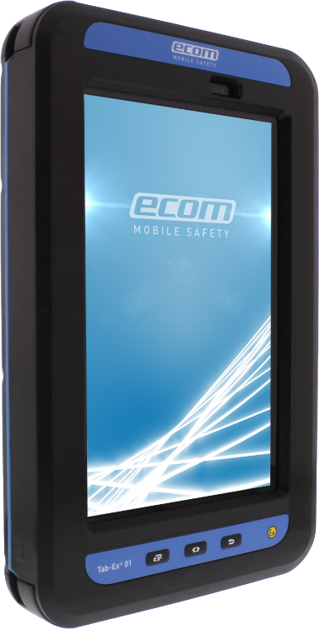
Tab-Ex® 01 Series
ATEX Zone 1/21 & Division 1 / ATEX Zone 2 & Division 2
World´s first Zone 1/21 / DIV 1 & the world’s thinnest Zone 2 / DIV 2 tablet computer
based on the Samsung GALAXY Tab Active.
FEATURES
TECHNICAL HIGHLIGHTS
Android™ 5.1.1, Lollipop Operating System
Quad core 1.2 GHz processor
Wireless capability as WWAN, 4G LTE*,
WLAN, etc.
8” TFT display with 1280 x 800 pixels
Memory and Storage:
RAM 1.5 GB & ROM 16 GB,
with microSD up to 64 GB (optional)
Reinforced security with Samsung KNOX™
Suitable for use with gloves
NFC technology for wireless applications
Wireless LAN: 802.11a/b/g/n
Zone 2 / DIV 2 only 13,8 mm (0.54”) thin.
Security: Samsung KNOX™
EMM (MDM+IAM)
Secure file management
H/W & S/W Secure platform
ACCESSORIES
Benefit from a wide range of accessories & peripherals e.g:
Charger
Leather cases
Adapters
Stylus holder
Docking stations
Headsets & more

Slide 4
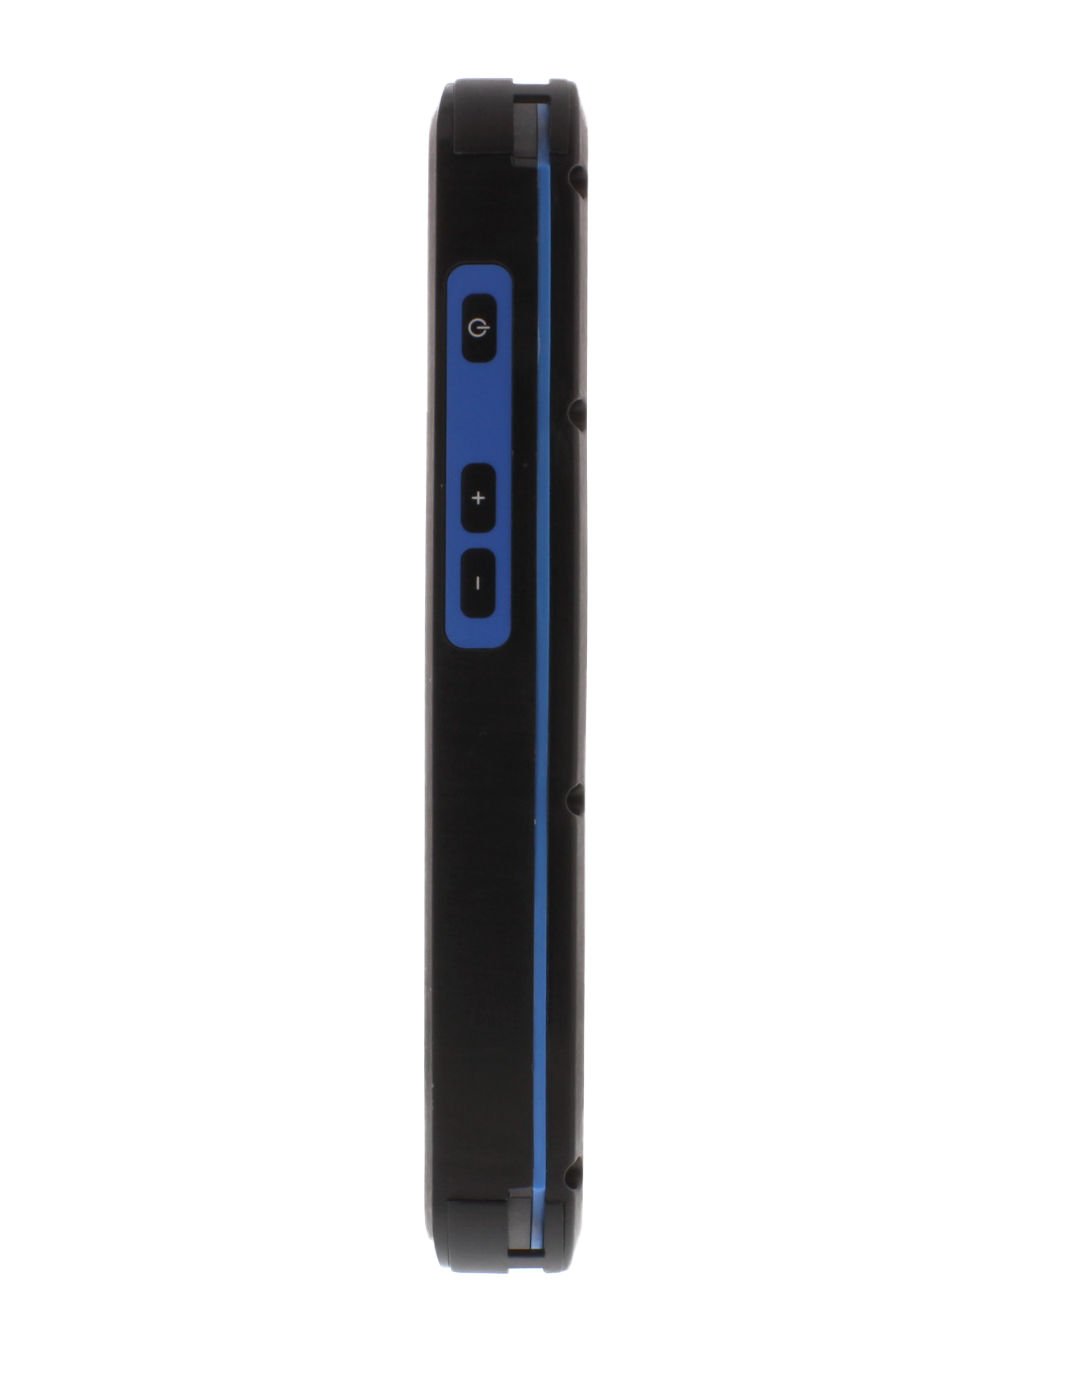
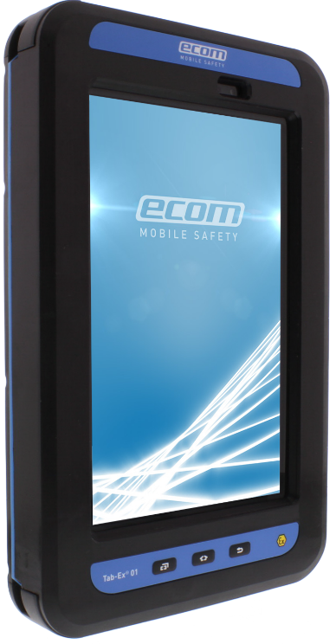
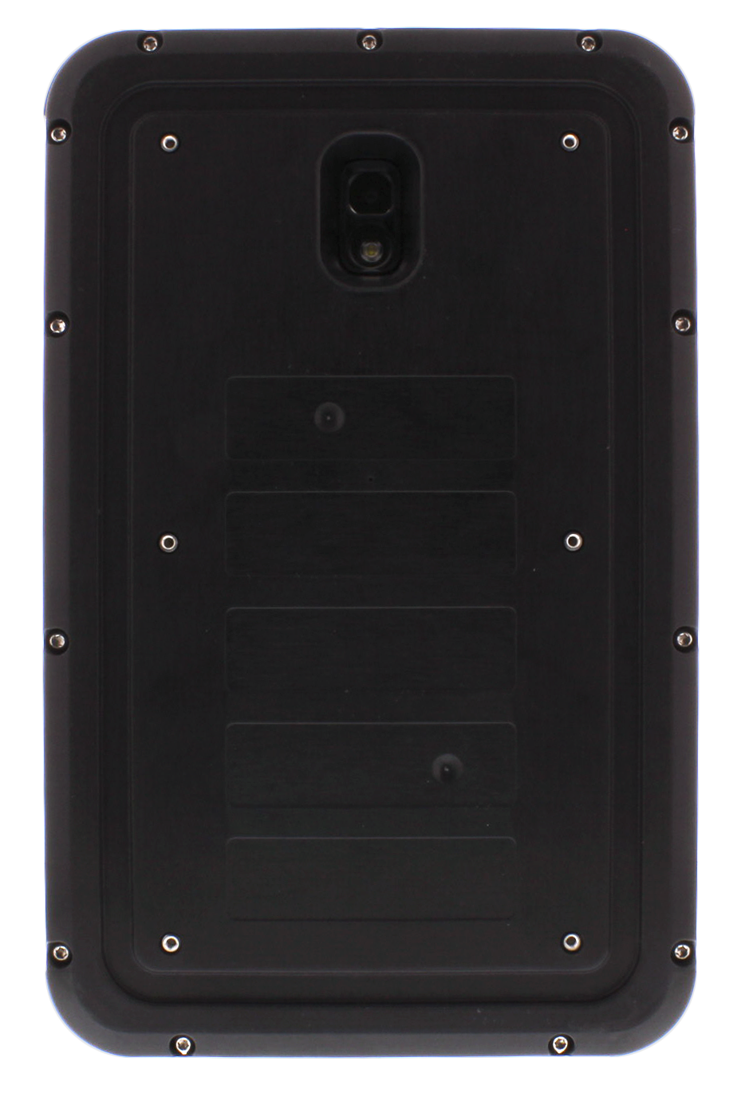
Tab-Ex® 01 DZ1
Functional Buttons & Ports
Rear camera
Front camera
Flash
Power button
Volume control
Multipurpose for magnetic
connector of safety box
Back
Last used Application
Home

Slide 5
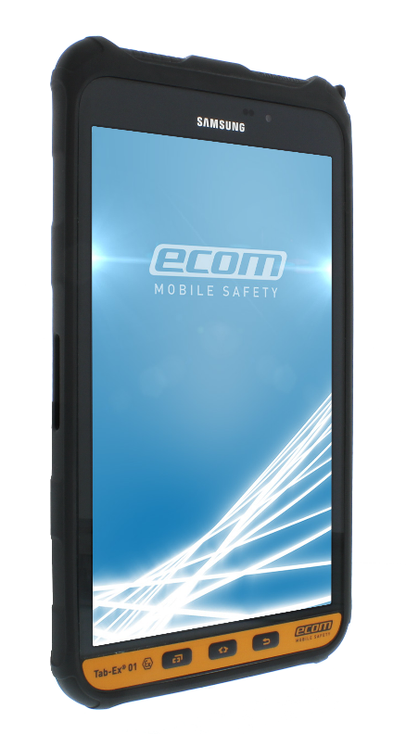
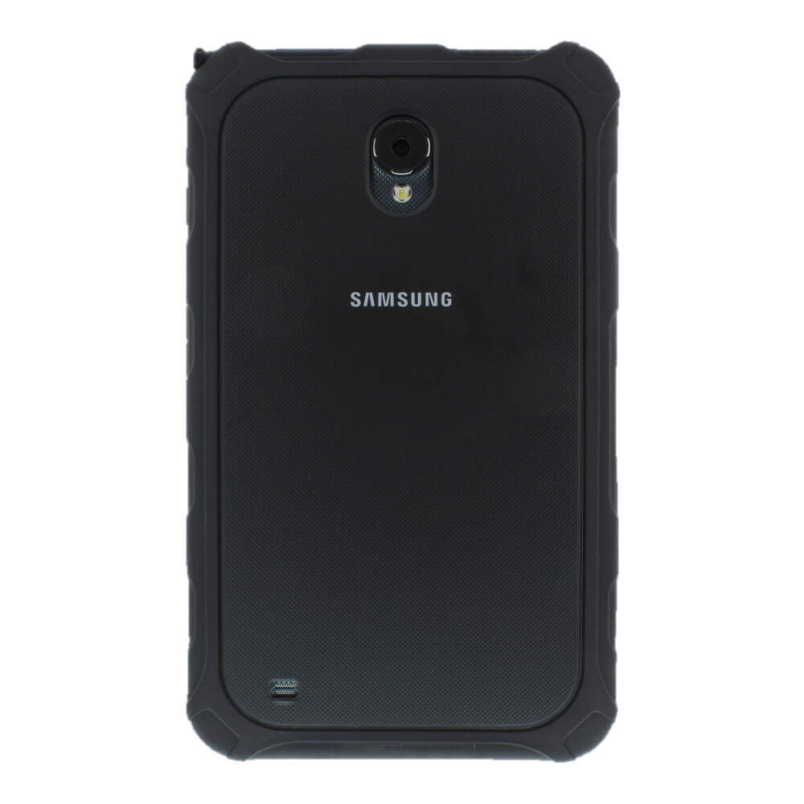
Tab-Ex® 01 DZ2
Functional Buttons & Ports
Front camera
Rear camera
Flash
Power button
Volume control
Charging
connector
Speaker
Headphone jack
Apps
Back
Home
USB port

Slide 6
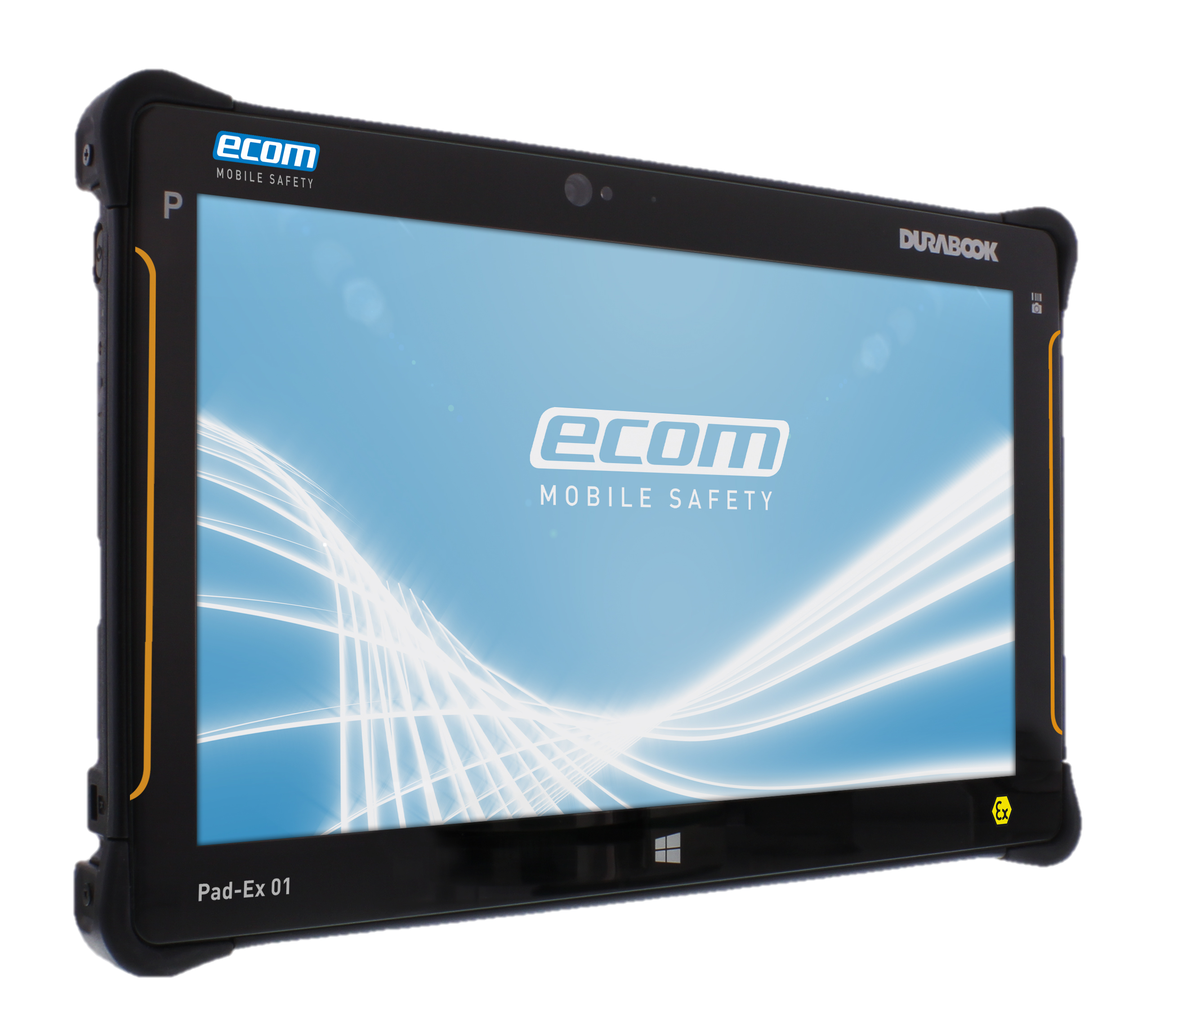
Pad-Ex® 01 Series
ATEX Zone 2 & Division 2
BENEFITS
Pad-Ex 01 redefines what a mobile Full Win tablet PC shall be:
Combining robust features and a large screen size, superior performance is ideal for field operatives of all sectors to complement or even substitute Desktop PC, laptop or wall mounted display.
Supports latest Bluetooth standards - allowing realtime connectivity to Bluetooth 4.0 Class 1.
Expanded capabilities such as data collection and measuring/monitoring devices, headsets, AutoID, and Bluetooth Beacons for localization.
Advanced data capturing functionality due to the Barcode Scanner (optional)
and the Bluetooth Reader/Scanner Ident-Ex® 01.
The Pad-Ex® 01 is suitable for multiple mobile worker roles performing a range of tasks, such as Asset Surveys, Material Tracking, Operator Rounds, Inspection and Maintenance.

Slide 7
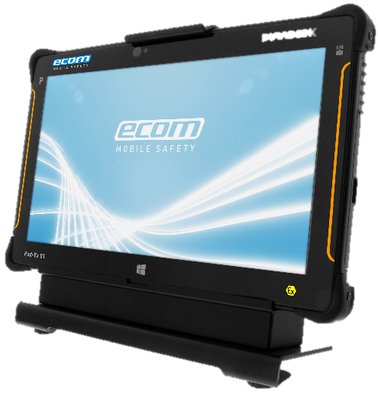
Pad-Ex® 01 Series
ATEX Zone 2 & Division 2
Pad-Ex 01 redefines what a mobile Full Win tablet PC shall be:
FEATURES
TECHNICAL HIGHLIGHTS
Full Windows 7 Pro / 8.1 Pro / 10 64 Bit
4th Generation Intel® Core™ i5 / i7 Processor
Wireless capability as WWAN, 4G LTE,
WLAN, etc.
11.6" HD (1366 x 768) LCD Panel
Memory and Storage:
RAM 4GB / 8GB & 128GB / 256GB
Micro SD Card slot support SDHC & SDXC
Support GPS / Augmented Reality
5MP Auto Focus Camera with LED Flash Light
Suitable for use with gloves
Intel Wireless AC7260 802.11 a/b/g/n/ac
Weight: only 1.2kg
Security: EMM (MDM+IAM)
ACCESSORIES
Benefit from a wide range of accessories & peripherals e.g:
Charger
Leather case
Docking stations
Adapters
RFID Reader
Headsets & more

Slide 8
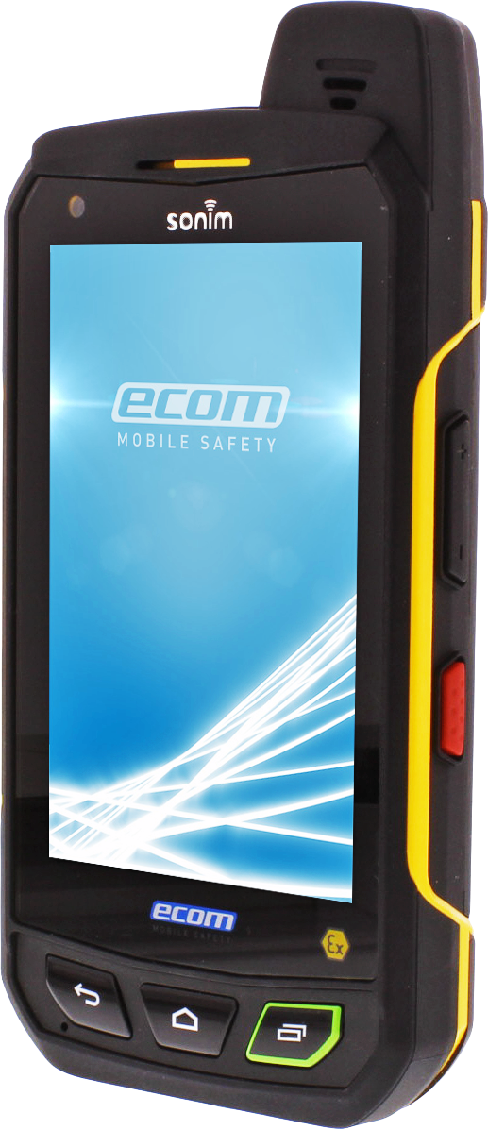
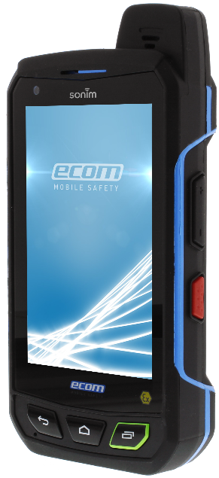
Smart-Ex® 01
ATEX Zone 1/21 & Division 1 / ATEX Zone 2/22 & Division 2
Delivering worldwide Mobility in Hazardous Areas.
FEATURES
TECHNICAL HIGHLIGHTS
4G / LTE -standard (SIM unlocked and free)
IP68
Android™ 4.4, KitKat - Android™ operating system
PTT Key / Yellow Key / Red Key
Camera: 8 MP rear with auto focus and LED flash with torchlight function / 1 MP front (optional)
4.0“ capacitive multi-touch screen made of extreme shock and scratch resistant Gorilla® Glass 2
High Visibility Display in Direct Sunlight
Speaker: 19 mm Loud Speaker with Gore® Protective Vents, Output up to 103 dB
5-pins water-proof magnetic USB 2.0 High Speed connector
Battery: Up to 1000 hours Stand by &
up to 40 hours talk time
NFC technology for wireless applications
Bluetooth® 4.0 incl. BLE (Bluetooth Low Energie)

Slide 9
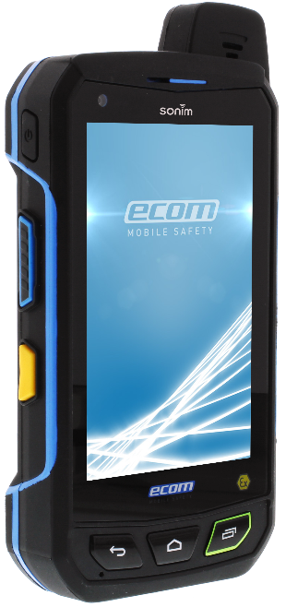
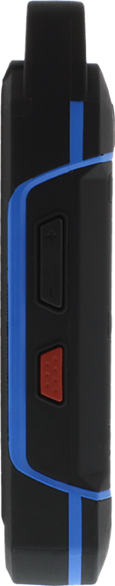
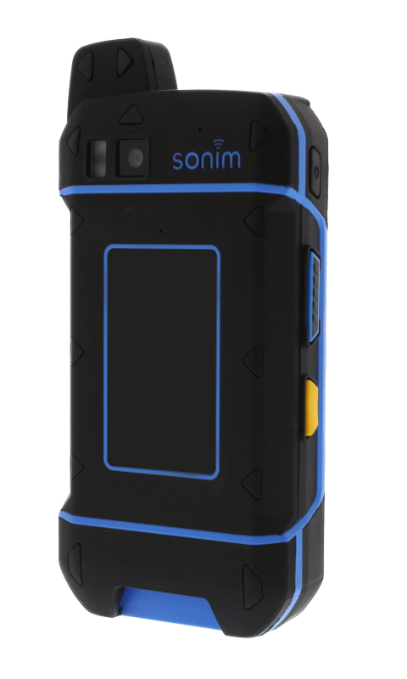
Smart-Ex® 01
Functional Buttons & Ports
3.5mm jack
Power
LED flash
SIM card slot
Camera
(optional)
Push to talk
Volume control
Apps
Alarm
Menu
Magnetic
USB Port
Back
Home

Slide 10
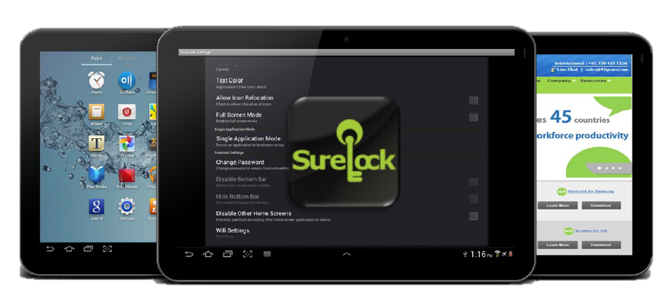
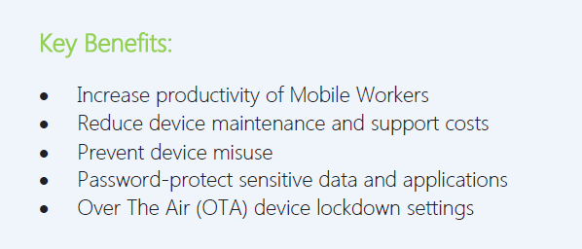
SureLock
Lockdown Tablets & OTHER Mobile Devices
Restrict users to allowed applications only
Lock down tablets and smartphones
Completely hide “HOME“ button or disable bottom bar
Run single application in kiosk mode
Disable application installation
Password protected administrator access
Hide allowed application from homescreen
Create custom layouts using icon relocation
Display allowed widgets on SureLock homescreen
Brand devices with your company logos, text and color scheme
Display custom icons (bmp, png, jpg format) on homescreen screen

